Slide 1

Energy Financial Markets Final Presentation
Data Analytics
Holly Shirmenzagas, Daniel Carrillo, Daniel Jackson

Slide 2

Energy Stock Fundamentals and Popularity vs Energy Stock Returns
Group: Holly Shirmenzagas, Daniel Carrillo, Daniel Jackson
Project Description: Energy stocks are widely known to have performed poorly over the last several years. Our goal was to analyze the fundamentals of the underlying companies to perhaps understand if their stock performance is warranted.
Research Questions to Answer: Do the margins support the stock performance of the energy / alternative energy sectors? Does the amount of cash distributed to shareholders matter? Sort / plot key performance indicators (KPIs) over time. Finally, how has the energy sector changed in popularity over the same few years. Would that impact returns?
Datasets: See sample list of companies on next slide; pulled data / stock performance / fundamentals from Alpha Advantage https://www.alphavantage.co/documentation/ and popularity (holdings information) from https://robintrack.net/

Slide 3

Companies
S&P 500 Energy Sector Components
Nasdaq / NYSE Alternative Energy Stocks
Ticker | Name | Exchange
APA | Apache Corp | S&P500
BKR | Baker Hughes | S&P500
COG | Cabot Oil & Gas Corp | S&P500
COP | Conocophillips | S&P500
CVX | Chevron Corp | S&P500
CXO | Concho Resources Inc | S&P500
DVN | Devon Energy | S&P500
EOG | EOG Resources | S&P500
FANG | Diamondback Energy | S&P500
FTI | Technipfmc Plc | S&P500
HAL | Halliburton Company | S&P500
HES | Hess Corp | S&P500
HFC | Hollyfrontier Corp | S&P500
KMI | Kinder Morgan | S&P500
MPC | Marathon Petroleum Corp | S&P500
MRO | Marathon Oil Corp | S&P500
NBL | Noble Energy Inc | S&P500
NOV | National-Oilwell | S&P500
OKE | Oneok Inc | S&P500
OXY | Occidental Petroleum | S&P500
PSX | Phillips 66 | S&P500
PSXD | Pioneer Natural Resources Co | S&P500
SLB | Schlumberger N.V. | S&P500
VLO | Valero Energy Corp | S&P500
WMB | Williams Companies | S&P500
XOM | Exxon Mobil Corp | S&P500
Ticker | Name | Exchange
BEP | Brookfield Renewable Partners | NYSE
AZRE | Azure Power | NYSE
BLDP | Ballard Power Systems | NASDAQ
CSIQ | Canadian Solar, Inc | NASDAQ
ENPH | Enphase Energy | NASDAQ
EVA | Enviva | NYSE
FSLR | First Solar Holding | NASDAQ
GPRE | Green Plains Renewable Energy | NASDAQ
OPTT | Ocean Power Tech | NASDAQ
ORA | Ormat Tech | NYSE
REGI | Renewable Energy Group | NASDAQ
SEDG | SolarEdge Tech | NASDAQ
SPWR | SunPower Corp | NASDAQ
RUN | Sunrun | NASDAQ
TERP | Terraform Power | NASDAQ
VSLR | Vivint Solar | NASDAQ

Slide 4
Issues With The Data
Started with 42 energy sector stocks (mix of energy and alternative energy)
The holder data was hourly (1mm rows) and had to narrow it down to 27 rows (monthly average shareholders) by company
The fundamental data had to be cleaned quite a bit and changed to float values
Some of visualizations didn’t show one of the reporting periods
Had to remove ticker: OPTT as it skewed some of our findings

Slide 5
If we had more time with the data..
Analyze the energy vs alternative energy more closely or look across sectors
Pull a few more fundamentals
Do a deeper dive into prior periods to give better context
Obviously, Covid had a significant impact on the stock market; would have liked to dive in a little further to the data over the last 4-5 months.

Slide 6
Energy Sector Returns vs Other Market Sectors
Over the last several years, the public energy sector has performed poorly relative to other sectors
The top 3 sectors by returns are shown below for comparative purposes
The goal of our project is to determine if key performance indicators or fundamentals support these poor returns
 | 1-Day | 5-Day | 1-mo | 3-mo | YTD | 1-yr | 3-yr
Energy | 0.26% | -4.18% | -3.76% | 0.19% | -40.23% | -38.81% | -44.13%
Information Technology | 2.49% | 5.89% | 7.53% | 27.47% | 23.56% | 43.62% | 101.01%
Consumer Discretionary | -0.55% | 0.64% | 6.09% | 24.99% | 15.54% | 22.12% | 56.89%
Health Care | 1.04% | 0.65% | 4.81% | 9.10% | 4.48% | 17.92% | 35.08%

Slide 7
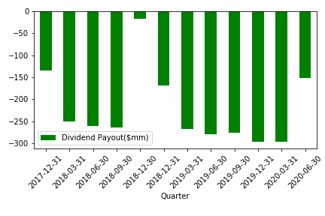
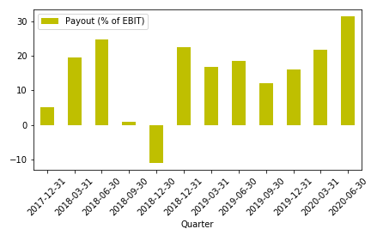
Key Visualizations
Over the last several years, the public energy sector on average has continued to make distributions to shareholders (chart on the left)
Relative to cash flow (Earnings before interest and taxes - EBIT), the energy sector on average has paid out about 20-30% of cash flow (chart on right), with a large chunk of companies paying out large portions of cash every quarter
Is this attractive to a potential investor?
Do investors want more than 25%?

Slide 8
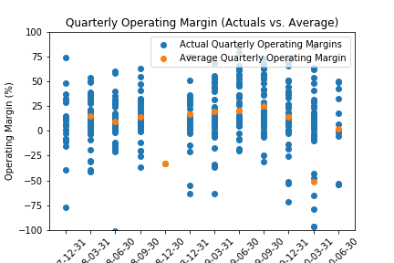
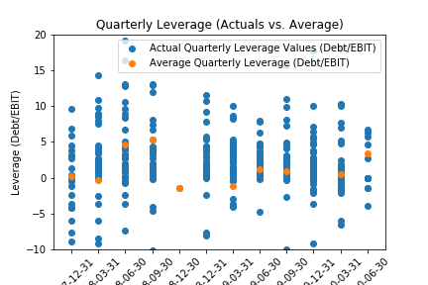
Key Visualizations (continued)
Are investors concerned with margins and cash flow available?
We looked at average margins (EBIT / Revenue) over the last 2+ years and found them to be well below 50%
We also looked at leverage (the measure of annual cash flow relative to debt outstanding == Debt / EBIT)
Debt was primarily between 0-5x greater than EBIT – most lenders require leverage below 4x

Slide 9
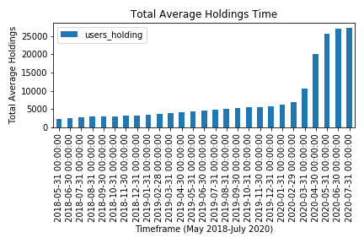
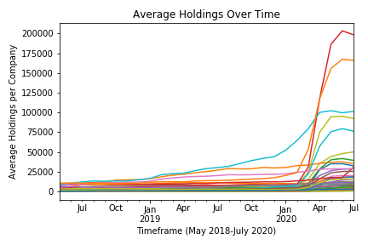
Key Visualizations (continued) -- Popularity
This presents the average number of holdings (across all 40+ companies) per month
Holdings per company for the last two years
Noticed a large spike in holdings right as Covid-19 pandemic began (you can see the change below in March)
Covid-19 begins

Slide 10
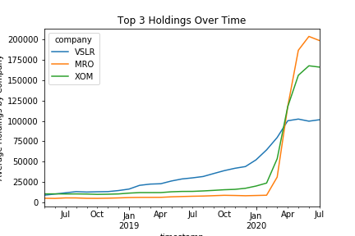
Key Visualizations (continued) -- Popularity
Average holdings for the top 3 companies (Marathon Oil, Exxon Mobil, and Vivint Solar)

